Slide 1

Entity Framework Core
Course Introduction
SoftUni Team
Technical Trainers
Software University
https://about.softuni.bg/

Slide 2
Table of Contents
Course Objectives
Training and Team
Course Organization
Course Infrastructure
Evaluation Criteria
2

Slide 3
Have a Question?
sli.do
#csharp-db

Slide 4














SoftUni Diamond Partners

Slide 5

Educational Partners

Slide 6

Course Objectives

Slide 7
Course Objectives
ADO.NET Library
ORM Fundamentals
Code First and Database First
Automapper Library
Advanced LINQ
JSON and XML
Best Practices and Architecture
ASP.NET Core
7

Slide 8
Practical Programming Exam
Three practical problems for four hours
Model Definition
Data Import
Data Export
Automated judge system
http://judge.softuni.bg
Solutions are evaluated for correctness only
Code quality is still not measured
8

Slide 9
Theoretical Exam
You will have 30 minutes once you enter
The exam questions will be in English
Automated quiz system
Available online the same day as the practical exam
You can submit your answers just one time
9

Slide 10

The Team

Slide 11
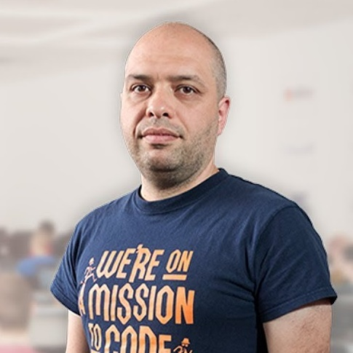
Stamo Petkov
Head оf Department @ Information Services Plc.
Worked with various technologies
.NET and C#, BASIC, Pascal, Object Pascal, PHP
20 years of experience
Experienced Lecturer
C# Basics and ASP.NET Core @ Softuni

Slide 12
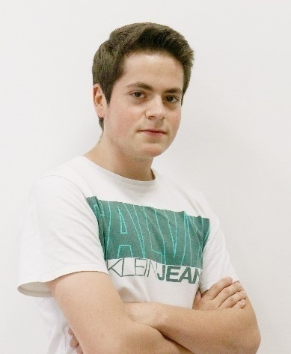
Kristiyan Ivanov
Top Student @ SoftUni
Technical Trainer @ SoftUni
Student @ Technical University of Sofia
Interests include mechanics and electronics
Automotive Software Development
Interested in coding with C#, Python, C++

Slide 13

Course Organization

Slide 14
C# Database Fundamentals Module – Timeline
14-Feb-2023
01-Apr-2023
11-Apr-2023
Entity Framework Core
7 weeks * 4 times / week
15 credits
Start: 14-Feb-2023
Final exam: 01-Apr-2023
Retake exam: 11-Apr-2023

Slide 15


SoftUni Certificate
Practical Exam 100%
Homework 5%
Evaluation
15

Slide 16
CPE Certificate
Practical Exam
Theoretical Exam
Evaluation
16

Slide 17

Homework Assignments & Exercises
Your homework is mainly work in class
Lesson days → slides + live demos + exercises
Exercise days → only exercises
How to submit your homework?
Submitted in the judge system
Do your homework when it's due
Assignments pile up quickly

Slide 18


Learn to Search in Internet
The course assignments require to search in Internet
This is an important part of the learning process
Some exercises intentionally have no hints
Learn to find solutions!
Software development includes everyday searching and learning
No excuses, just learn to study!
Developers learn new technologies, tools, languages every day!

Slide 19



Course Web Site, Forum and FB Group
Official web site:
Official discussion forum:
Official Facebook group:
https://softuni.bg/trainings/3966/entity-framework-core-february-2023
https://softuni.bg/forum/categories/63/module-csharp-db
https://www.facebook.com/groups/CsharpDbJanuary2023

Slide 20
Questions?
Notes:
20

Slide 21
Trainings @ Software University (SoftUni)
Software University – High-Quality Education, Profession and Job for Software Developers
softuni.bg, about.softuni.bg
Software University Foundation
softuni.foundation
Software University @ Facebook
facebook.com/SoftwareUniversity
Software University Forums
forum.softuni.bg
21
Notes:
21

Slide 22

License
This course (slides, examples, demos, exercises, homework, documents, videos and other assets) is copyrighted content
Unauthorized copy, reproduction or use is illegal
© SoftUni – https://about.softuni.bg
© Software University – https://softuni.bg
Notes:
22

